Slide 1
Classifying vortex wakes using neural networks
by Kuanyshova Ayaulym

Slide 2
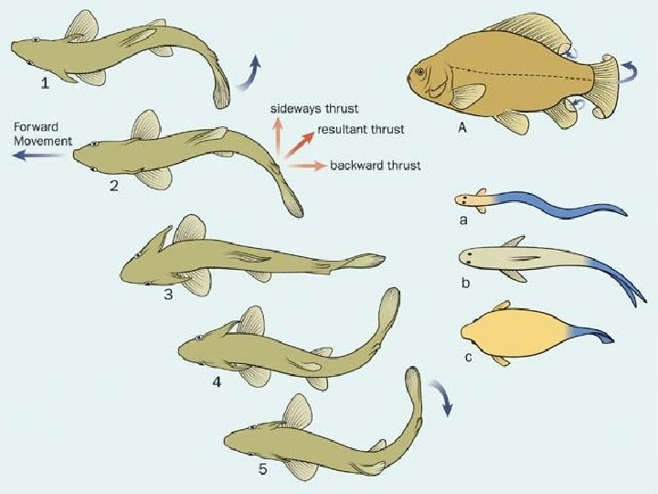
The article background
Inspired from aquatic organisms having specialized sensors on their bodies to detect bodies in front of them
Organisms can distinguish different wakes relying on local flow information
We can also classify the wake type(2S, 2P, etc.) as a function of a body parameters

Slide 3
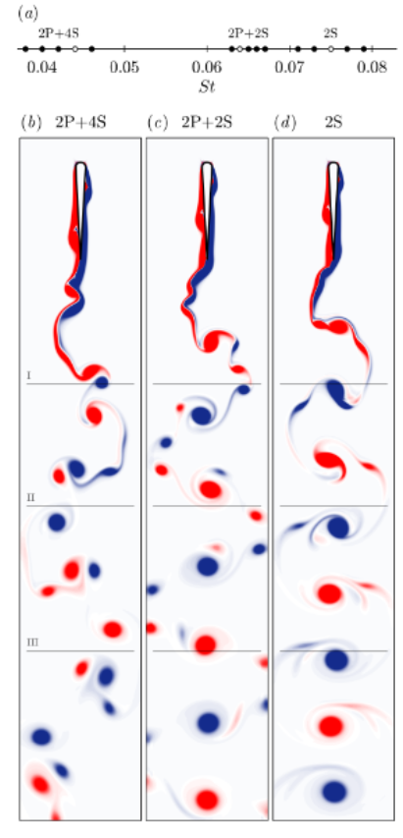
The article problem
Hard to distinguish 2P, 2P+2S, 2P+4S vortices.
We need to generate a big data with these 3 types of vortices
Use the data to train NN to distinguish them
Evaluate the trainings by measuring it’s accuracy in correctly classifying the data reserved for testing

Slide 4
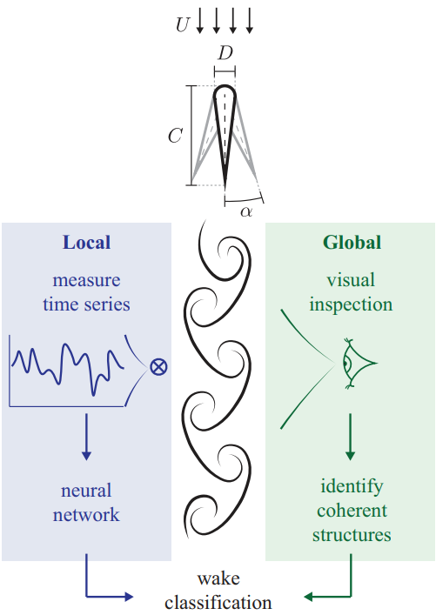
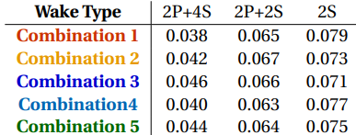
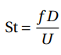
3 types of vortex wakes generated by a symmetrical airfoil oscillating at different St
In total 12 oscillations(12 different St) were saved and used for training
The Strouhal number(St) is a dimensionless measure of the oscillation frequency
ƒ – frequency of oscillations
D – diameter of the airfoil
U – velocity of the uniform free stream

Slide 5
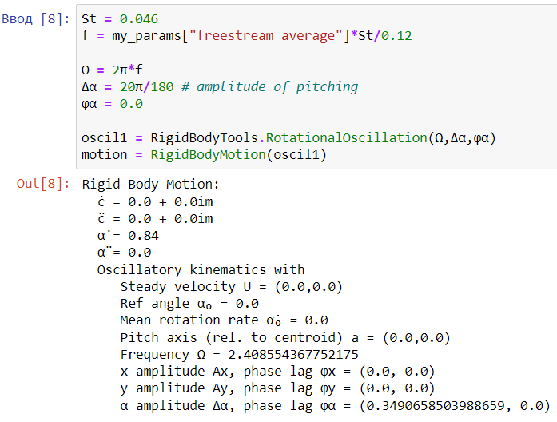
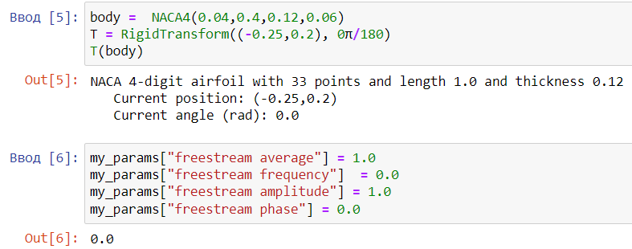
Used methods
Data collection
1. First, we need to state the body parameters, it’s motion equation.
2. To obtain numerical data of the wake, to generate data of vorticity scalar field ω(x, t) i.e. ω = ▼x u, we solve the incompressible Navier-Stokes equations

Slide 6
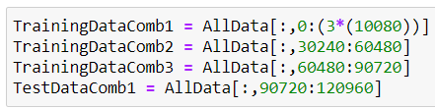
The N x M or 210 x 120960 matrix was made.
N = $\frac{T}{∆t}=\frac{2,52}{0,012}$
M = $10080 ∗12(St numbers)=120960$
Each combination has 5 x 2016 gridpoints i.e. 10080 columns with all distinct snapshots from one St number
Every training data has 3 of such 10080 columns making 30240 columns in total
3 training data combination and 1 test data combination were made

Slide 7
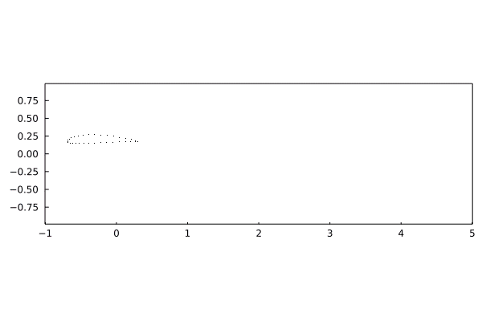
First steps
No flow stream was applied

Slide 8
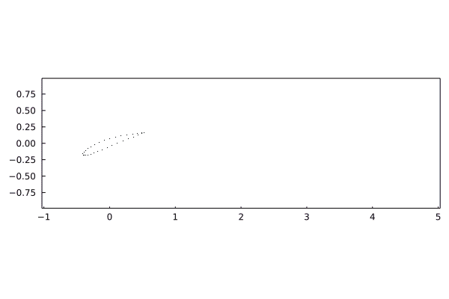
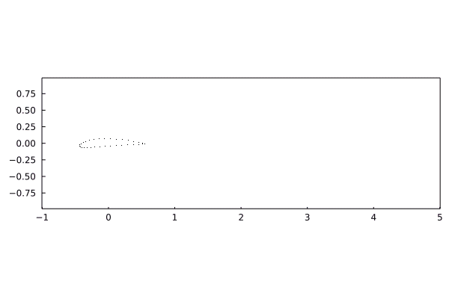
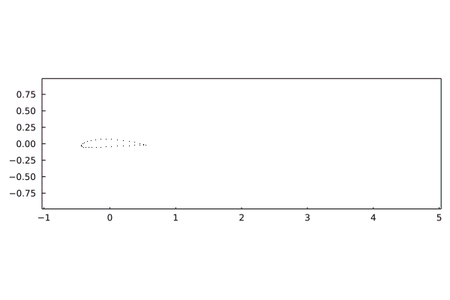
Visualization of airfoils with vary St numbers
St = 0.065(2P+2S)
St = 0.038(2S+4P)
Flow stream was applied
St = 0.078(2S)

Slide 9


St = 0.046(2P+4S)
St = 0.071(2S)

Slide 10
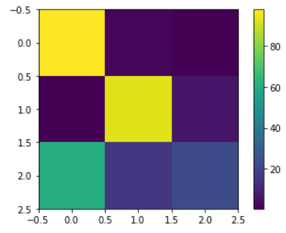
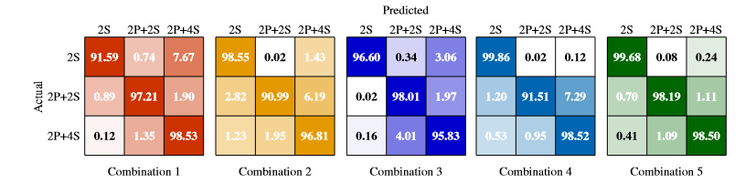
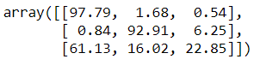
Confusion matrices
The confusion matrix got by me
The confusion matrices for the classification task in article
2P+4S
2P+2S
2S
2P+4S
2P+2S
2S

